Slide 1
AIR QUALITY INDEX MEASURER
RA2211003010626 – NIPUN DHIMAN
RA2211003010628 – RIFATH HOSSAIN
RA2211003010650 – AMAN SHAW

Slide 2
WHAT DOES IT DO?
An Air Quality Index (AQI) is a number used to measure the air pollution levels and communicate it to the population.
This model calculate the air quality index and predicts whether the conditions are good or bad
This model also gives steps to stop the pollution depending upon the condition and also provides the location of the areas on the map with higher rates of AQI.

Slide 3
THINGS USED
01
02
PYTHON
JUPYTER
04
03
DATABASE
STREAMLIT PYTHON
Programming Language
Notebook format
From “data.gov.in”.
Can be downloaded or used as an API
Library for making GUI Template

Slide 4
RESEARCH PAPERS
Research Article Name | Publishers and Authors | Article Links
Air Quality Prediction using Machine Learning Algorithms – A Review | IEEE (Tanisha Madan; Shrddha Sagar; Deepali Virmani) | https://ieeexplore.ieee.org/document/9362912
Real time Air Quality Index from various locations | Ministry of Environment, Forest and Climate Change Central Pollution Control Board | https://data.gov.in/resource/real-time-air-quality-index-various-locations
Long short-term memory neural network for air pollutant concentration predictions: Method development and evaluation | Xiang Li, Ling Peng, Xiaojing Yao, | https://www.researchgate.net/publication/319714176_Long_short-term_memory_neural_network_for_air_pollutant_concentration_predictions_Method_development_and_evaluation

Slide 5
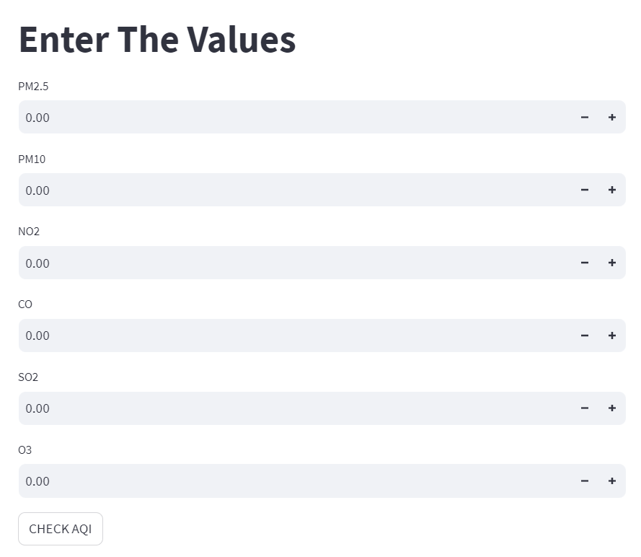

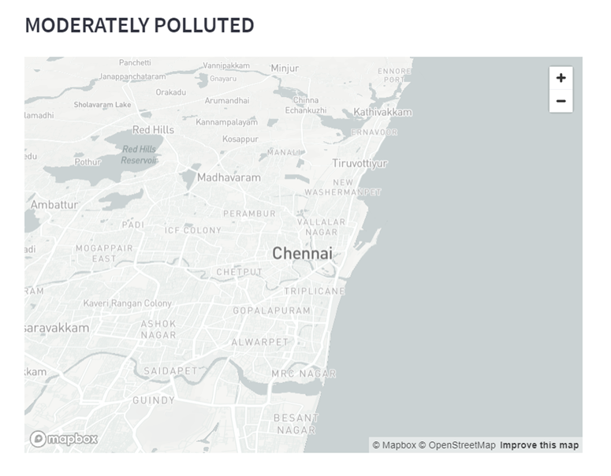
GUI INTERFACE CONCEPT

